Slide 1
Types of society

Slide 2
Ancient Society
Hunting and gathering society
Hunting / gathering society is the oldest and the simplest type of society.
It relies heavily on hunting wild animals and gathering food for its survival.
Example: Bushmen of Southwestern Africa Hunting
These societies consist of very small but scattered groups.
Statuses in these societies are essentially equal and hence the difference between the leader and followers is not there.
Most decisions are made through group discussion.

Slide 3
Their needs are simple and easily satisfied
Political institutions are absent,
The social structure of these societies is necessarily very simple,
Their culture cannot become elaborate and diversified
Hunters and gatherers constantly face the danger of extinction in a struggle against adverse environments
Limited or no division of labor
There is no gender inequality.

Slide 4
Pastoral society
Pastoral societies are those whose livelihood is based on pasturing of animals, such as cattle, camels, sheep and goats.
The first pastoral societies emerged between 10,000 and 12,000 years ago,
Many pastoral societies still exist in the modern world, particularly in Africa and the Middle East.
Pastoralism is a much more reliable and productive strategy than hunting and gathering.

Slide 5
Horticulture society
Horticultural are those whose economy is based on cultivating plants by the use of simple tools, such as digging sticks, hoes, axes, etc.
Horticultural societies developed around 7000 BC in the Middle East and gradually spread west through Europe and Africa and east through Asia.
Cultivation is more often a female responsibility in horticultural societies than in agrarian societies
Polygamy—when a husband has multiple wives—is common.

Slide 6
Agriculture society
An agrarian society focuses its economy primarily on agriculture and the cultivation of large fields.
The first agrarian societies arose approximately 5000 to 6,000 years ago in Mesopotamia and Egypt and slightly later in China and India.
Simple living pattern
Emphasis on agriculture and farming as the primary method of subsistence
Agrarian farmers work much harder than do the members of earlier types of societies.

Slide 7
Most members of agrarian societies are peasants.
Non-mechanised agriculture
Grow most of own food etc to meet most of subsistence needs.
They also grow a surplus to sell etc.
Status of women is usually low.

Slide 8
Feudal Society
It was in Europe, especially in England, from about the 9th to the 12th century.
The piece of land was called the manor.
It was land base production system.

Slide 9
The King/Monarch
It was believed that land has been gifted by God to the king and king is the real owner of the land.
The king believed he was given the right to rule by God. This was called "divine right".
The king had total control over all the assets and he used to decide as how much quantity of land to provide on lease to the barons.
In case any of the barons exhibited poor performance, the king had the power to withdraw the land and give it to any other person belonging to the baron class.
All the judicial power was in the hands of the king.

Slide 10
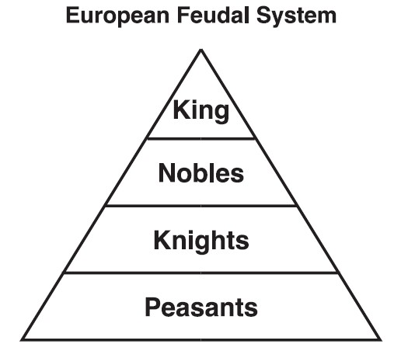

Slide 11
Barons/Nobles
The Barons in the feudal system social hierarchy were the second wealthiest class.
They were called as the Lord of the Manor.
They established their own legal systems, designed their own currency and set their own tax regulation schemes.
the Barons had to perform the following functions for them:
They had to serve the royal council.
They had to provide the King with Knights to tackle with any form of war.
They had to provide food and lodging facilities to the king, when they traveled to different locations.

Slide 12
Knights/Vassals
The Knights were provided the leased land by the barons and in return, they provided military service to the king at the time of need.
They also had to protect the Baron and his family.
They keep a part of the land provided to them by the Barons and distribute the rest of the lands to the Villeins.
They also used to set their own taxation and rent guidelines for the Villeins.
Their main job role was to give protection to the king and therefore they were paid quite well.

Slide 13
Villeins/Peasants
The Villeins were granted land by the Knights.
They had to provide food and service to their superior classes on demand.
They were not allowed to leave the Manor without prior permission.
They had no rights to marry without the permission of their Lords.
Around 90 percent of the people worked the land as peasants.
Peasants worked hard and died young. Most were dead before they reached 30 years old.
They used to be the poorest class in the feudal system social hierarchy.

Slide 14
There were two groups of peasant workers on the manor
Freemen- skilled workers who paid rent and could leave the manor whenever they wished. (They usually had a skill needed by others on the manor.)
Serfs – workers bound to the land by contract with the nobles. (They had no freedom - they where the baron/noble’s property.)

Slide 15
Capital society
Capitalism is an economic system in which capital goods are owned by private individuals or businesses.
The production of goods and services is based on supply and demand in the general market (market economy), rather than through central planning (planned economy or command economy).
The Social Work Dictionary,1995:
Capitalism is an economic system in which the production and distribution of goods and services for consumers are controlled through private ownership and open competitions.
Adam Smith is often referred to as the “Father of Capitalism.”

Slide 16
Features of Capital society
According to Dictionary of Sociology:
1. Private ownership of land and capital resources by individuals, partnerships and corporations
2. Competition primarily for profit for the owners
3. Much stimulation of enterprise
4. Increase of inventions
5. Improvement of technical process
6. High specialization of finance in particular
7. Rapid enlargement of production
8. World wide extension of commerce
9. Growth of large powerful corporate organizations producing
10. Some private control of government
11. Increasingly powerful labor organizations that are securing improved status and influence of the workers.

Slide 17
Social Consequences of Capitalism
Over emphasizes profits and neglects group interests
No guarantee that profits and economic activities will be used for the interests of the society
Leads to labor exploitations
Workers suffer from a sense of job insecurity
Develop self-centered mentality
Conflicts between employers and employees
Destruction of Human Values
Materialism
Greed for Wealth

Slide 18
Thank you

